Slide 1
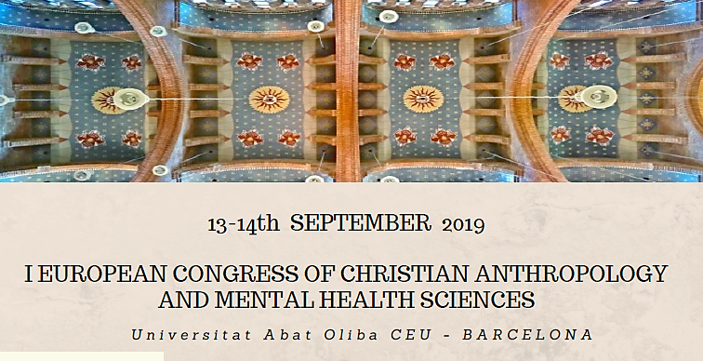
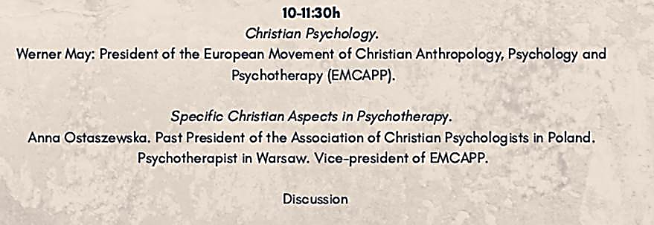

Slide 2
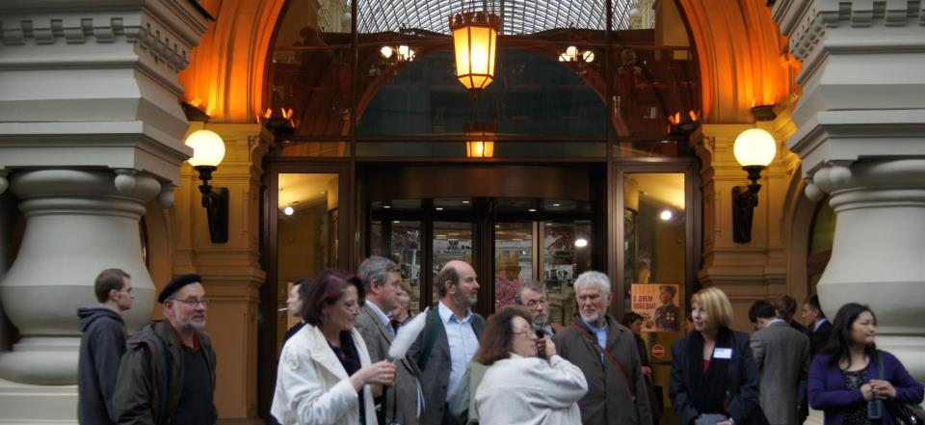
"Christian psychology - a challenge for me!" Werner May
"Truth can be discovered
in conversations between friends
who are different.“
Notes:
"Christian psychology - a challenge for me!"
Werner May
I would like it to say welcome to you with a basic idea of EMCAPP:
"Truth can be discovered in conversations between friends who are different."
We have experienced this over the decades at EMCAPP, and I am pleased to be able to experience that at this conference, not just to see old friends, but to get to know more colleagues, for whom it is important to bring together psychology and Christianity.
"Truth can be discovered in conversations between friends who are different."
>>> prayer
I have changed my presentation title a bit into "Christian Psychology - a challenge for me!"
I would like to briefly address five challenges for me and thus also challenge you.

Slide 3
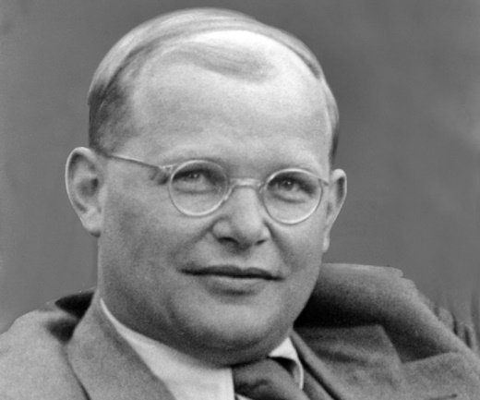
Challenge 1: The Reality?
The well-known German theologian
Dietrich Bonhoeffer wrote:
"The place where the question regarding the reality of God and that regarding the reality of the world receive an answer simultaneously is known by only one name: Jesus Christ. In this name God and the world are encompassed. All things have their being in Him (Col. 1:16). From now on, it is not possible to speak accurately about God and the world without speaking of Jesus Christ. All definitions of reality which ignore Him are abstractions."
Notes:
Challenge 1: The Reality?
The well-known German theologian Dietrich Bonhoeffer wrote:
"The place where the question arises concerning the reality of God."
In this name God and the world are encompassed. All things have their being in Him (Col. 1:16). From now on, it is not possible to speak. All definitions of reality which ignore Him are abstractions "(p.207)
In other words, our divine relationship with the triune God should be a fundamental reality for psychology. Or as Eric Johnson, my American friend, puts it in his article: Jesus, the Lord of Psychology.

Slide 4
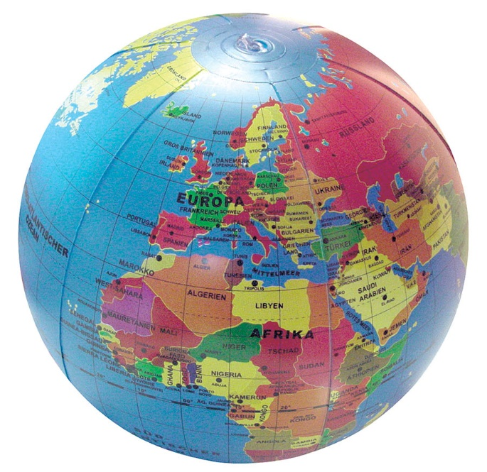
Challenge 1: The Reality?
In EMCAPP we encourages one another
to meet our national challenges and responsibilities.
Each country has its own challenges:
The role of Christianity, the position of psychology
and psychotherapy, or the social and political problems in the US are
different from those in Russia or in South Africa.
With respect to our different
Home country and culture
Language
Psychological education and experiences
church membership
practiced spirituality
Notes:
In EMCAPP we encourages one another to meet our national challenges and responsibilities.
Each country has its own challenges: The role of Christianity, the position of Psychology and psychotherapy, or the social and political problems in the US are different from those in Russia or in South Africa.
We meet with respect to our different
Home countries and cultures
Languages
Psychological education and experiences
church memberships
Practiced spirituality

Slide 5

Challenge 2: Humans as relational beings are also part of systems.
Psychology as a Western science is very individualistic, person centered, and does not pay much attention to the systemic links of the individual.
Notes:
Challenge 2: Humans as relational beings are also part of systems.
In her review of Gladys Mwiti’s (Kenya) book on Christian Counseling in an African Perspective, my wife wrote about that perspective:
“In contrast to western understandings of the self - the holistic African understanding of every individual is as a person within a community. Spiritual, mental, biological, genetic, behavioral, and social elements cannot be understood separately. Therefore, counselling in Africa will need to be guided by approaches that are holistic in nature…”
Psychology as a Western science is very individualistic, person centered and does not pay much attention to the systemic links of the individual.

Slide 6
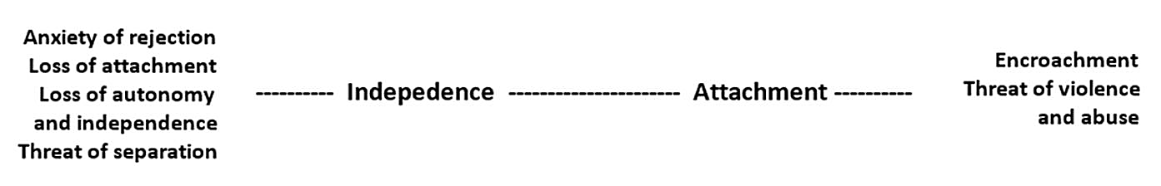
Our global challenge in a nutshell
We all face the life-long task of living out the healthy rhythm between independence and attachment.
At these two poles we have to deal with the fear of dependency and abuse by too much familiarity at one side and on the other the fear of isolation by too much independence.
This task was described by the French philosopher Levinas (1985) and the Swiss psychiatrist Riemann (1990).
I am person
I am living in and from relationships
Notes:
The French philosopher Emmanuel Levinas, as well as the Swiss psychiatrist Riemann, described the challenge for all of us as a field of tension to become an independent person and at the same time to live out of communion with others, a lifelong task for each of us and a challenge too: because there are two fears about these two healthy Poles, the fear of dependency and abuse on the one hand by too much familiarity and on the other the fear of isolation, by too much independence.

Slide 7
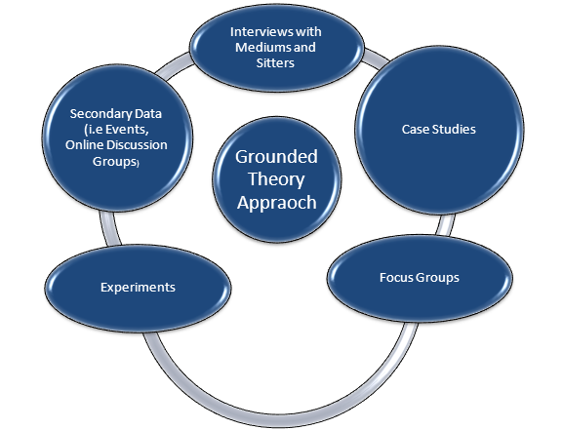
Challenge 2: Humans as relational beings are also part of systems.
We should use more qualitative methods to achieve not just average values, but the uniqueness of each human being, to better explore its systemic integrations and the evolution of systems themselves.
Notes:
For me, as a psychologist who loves science theory and who appreciates empirical research, another major challenge here is whether, in addition to quantitative methods, we should use more qualitative methods to achieve not just average values, but the uniqueness of each human being, to better explore their systemic integrations and the evolution of systems themselves.
For example, Glaser and Strauss's Grounded Theory seeks to formulate a new theory with the help of a constant change of data collection and analysis of interviews, observations, and other empirical data.
Not to lose the relational aspect is a great task of the future, because research more and more tends to concentrate in and to understand the neuronal and biochemical processes of the individual better and thus more effectively can influence human life. A keyword: transhumanism.

Slide 8

Challenge 3: Thinking psychological results deeper / wider.
An example
Notes:
Challenge 3: Thinking psychologic results deeper / wider.
An example:
I just could not get along with a certain older colleague when she was ill. I felt manipulated by her and was unsure how to deal with her. Actually, I had nothing against her, on the contrary, she had always been loving and helpful to me, and we had already had many good fights together for our concerns.
At some point it became clear to me that when I was about 15 years old, I made an important decision. I swore I will never again be manipulated by my mother and her illnesses. Probably helpless, how she should cope with her pubescent son, she accused me again and again, I'm to blame for her diabetes if I would not change my behavior. If I continued like this, I would bring her to the grave.
These accusations made me helpless and powerless. So my decision not to let myself be influenced by them, no matter what would happen to my mother, was in a sense a liberation. "Even if she dies, I will not let myself be influenced by this argument!"
From that day on chains fell off of me.

Slide 9

Challenge 3: Thinking psychological results deeper / wider.
Notes:
But at what price? Since then, I have not been able to deal with illness without being stressed. I avoided the sick people, thus renouncing important experiences of mercy, comfort and love. And if I could not stay out of the way of sufferers, like my colleague more than 30 years later, I was under the same pressure I had when I was a teenager.
After decades, I realized the influence of this youthful decision. Although I could understand it as a creative solution for a helpless adolescent protecting himself (who, for example, had no one to assist him with advice and did not know the God he could have escaped to), I still can not assess it as a correct one.
When I took back this decision in prayer and entrusted myself to God that he should be my protection and asked him to make me open for sick people, the walls fell between me and my colleague.

Slide 10
Challenge 3: Thinking psychological results deeper / wider.
Notes:
I had discovered a so-called Inner vow - as it was called by John and Paula Sandford - and took it back, and under these conditions could experience a whole new freedom in this area.
Inner Vows are forgotten, they work, but they can be brought to light. Even if we think differently now, yet they control our experience and behavior.
A cognitive psychologist recognizes in the inner vows so-called cognitive upper doctrines and treats them for example in the decision therapy.
A Christian psychology asks the following questions:
What are cognitions? Are they purely intrapsychic processes or do they have a transcendental meaning? Are they spiritually neutral?

Slide 11
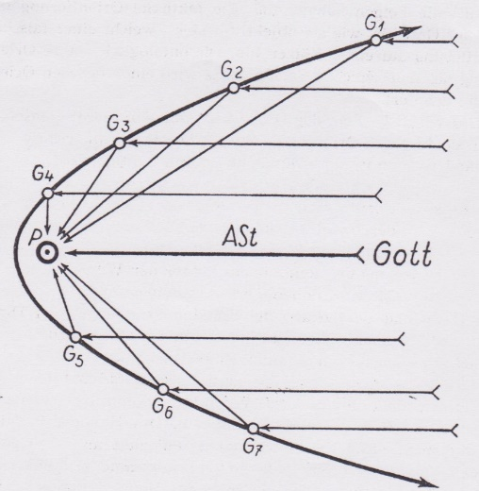
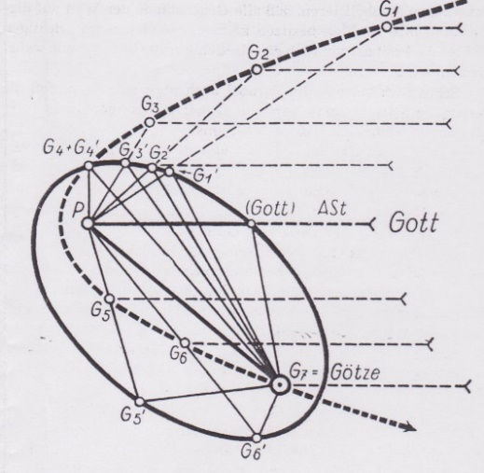
Notes:
An illustration by the Austrian Daim wants to challenge us.
First of all, the picture of salvation.
God's view of us and ours of God is not hindered, nothing stands in the way, and all our spheres of life (G1, G2, etc.) are in the light of the truth and love of God.
But in real life, it is not like that. Things that are more important to us than God (idols) obscure and block the light of God and his sight. Like these inner vows.

Slide 12
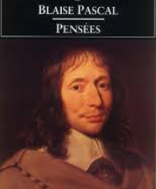
Future Challenge 4: Love - in three dimensions
Blaise Pascal (1623 - 1662)
"All the bodies, the firmament, the stars, the earth and the
kingdoms do not count as much as the smallest of spirits, for he
knows about all this and about himself, and the body knows
nothing.
And all bodies and all spirits together and all their works
do not count as much as the slightest movement of love;
for love belongs to an incomparably more sublime one
formation / order."
Notes:
Future Challenge 4, "Love - in three dimension"
Should Christian psychology not focus on the basic theme of this world and foreground it? I mean love, agape love.
Without love everything is nothing. To love, in everything we do is our greatest challenge and that is true for every human being.
Blaise Pascal (1623 - 1662)
"All the bodies, the firmament, the stars, the earth and the kingdoms do not count as much as the smallest of spirits, for he knows about all this and about himself, and the body knows nothing.
And all bodies and all spirits together and all their works do not count as much as the slightest movement of love; for love belongs to an incomparably more sublime formation. "
With Eric Johnson I am planning a joint book with the working title "Love - in three dimensions".
These "three" are: God, His Son and the Holy Spirit, but also Eros, Agape and the love of friendship, Philia and above all a trinitarian co-existence: God, you and me.

Slide 13

The current challenge 5: The reconciliation with saying No
My call:
We need a reconciliation with the no. And that will not only build our trust in each other, but also lead to reconciliation with a God who not only says yes but also no. Both, yes and no, are good, his promises as well as his commandments, for His Yes and his No to us are love. And His Not Yet, challenges us to patience and future confidence to wait until the time is right, no matter what.
Notes:
The current challenge 5: The reconciliation with saying no
For more than 20 years, I have been working on the concept with the English title "The Healing No," (in German: Nein5xJa, a no carried by five yes) a concept to deepen relationships and build trust, rather than disrupting it. We need a No, a Yes and a Not yet, which I call "The Bare Basics of Relationship", which builds trust.
I assert that every nation in the world has found its own solution, how to deal with the mistrust, which we fear if we say no, all cultures, whether more shame orientated or more guilt orientated.
This call of a Christian psychology starts from the biblical account of the Fall, where we are told how the first no of God, not to eat from the tree of knowledge, has developed mistrust. My call: We need a reconciliation with the no. And that will not only build our trust in one another, but also lead to reconciliation with a God who not only says yes but also no. Both, yes and no, are good, his promises as well as his commandments, for His Yes and his No to us are love. And His Not Yet, challenges us to patience and future confidence to wait until the time is right, no matter what.
The challenge for me is to have dealt with a topic that I consider to be a heart's desire of God, without a direct Christian reference becoming visible. That, too, is Christian psychology.

Slide 14
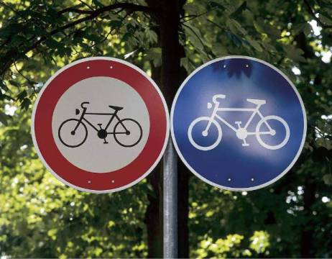
This challenge 5 is an old challenge
The challenge for me is to deal with a topic that I consider to be a heart's desire of God, without a direct Christian reference becoming visible. That, too, is Christian psychology.
In modern times psychology and science in general have questioned
Christian faith and, on the other hand,
Christians have questioned psychology.
In church history the same happened
between philosophy and Christian faith.

Slide 15
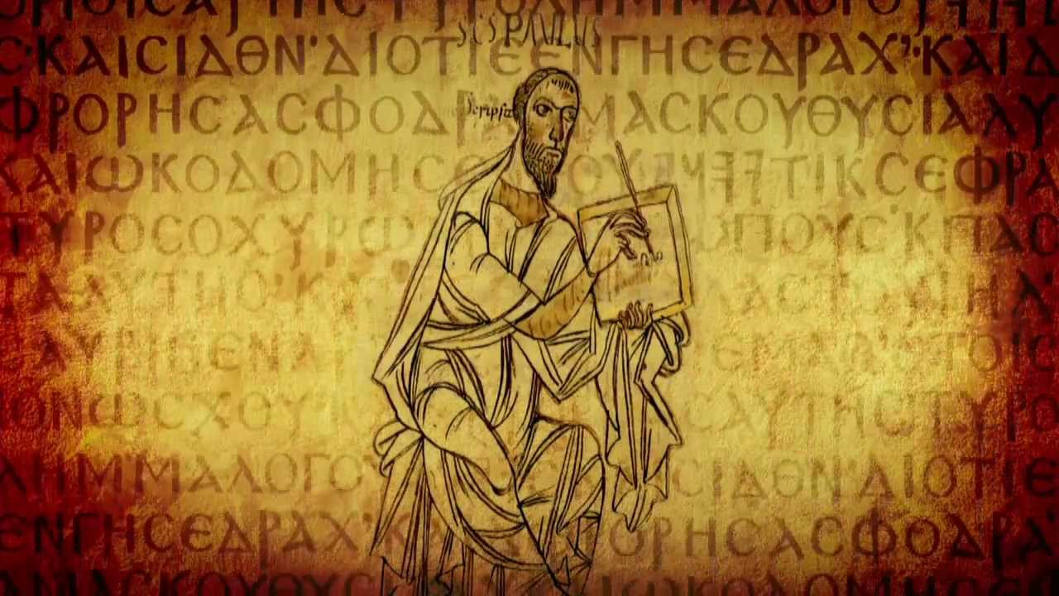
The relation between philosophy and faith - four remarkable positions in church history
The bible only – Tertullian (died after 220)
“Plundering the Egyptians” – Origines (died around 254)
“Cutting hair and nails” - Hieronymus (died 419/420)
“Like bees” Basilius the Great (died 379) suggested, we should act like the bees. They freely and fearlessly fly to certain flowers, choose the best nectar and transform it into something new, into honey.
In the same way, we should fearlessly walk towards the ideological concepts, but just take their nectar, their ideas, as an impulse, an impulse, which we then transform into something really new, like honey.
Notes:
The relation between philosophy and faith - some remarkable positions in
church history (see Graupner 1999b)
In modern times psychology and science in general have questioned Christian faith and,
on the other hand, Christians have questioned psychology. In church history the same
happened between philosophy and Christian faith.
As some of the ideas can help us for our actual discussion between psychology and
faith, I will introduce four of them:
The bible only: Tertullian (died after 220) says: “What does Athens have to do with Jerusalem? What the academy with the church?” The bible only.
“Plundering the Egyptians” (Origines, died around 254) refers to Exodus 3, 21-22, recommends to “ plunder the Egyptians”, that means, to use the best of worldly thinking for one’s own use.
“Cutting hair and nails” - Father Hieronymus (died 419/420): Deuteronomy 21, 10ff, to verify secular models within a biblical framework with a kind of “selection-filter”.
“Like bees” Basilius the Great (died 379) suggested, we should act like the bees. They freely and fearlessly fly to certain flowers, choose the best nectar and transform it into something new, into honey.
In the same way, we should fearlessly walk towards the ideological concepts, but just
take their nectar, their ideas, as an impulse, an impulse to think about, which we then
transform into something really new, like honey.

Slide 16

Welcome to a blessed honey harvest

Slide 17
References
Barney G. Glaser, Anselm L. Strauss: The Discovery of Grounded Theory. Strategies for Qualitative Research. Aldine, Chicago IL 1967, (deutsch Grounded Theory. Strategien qualitativer Forschung. Huber, Bern u. a. 1998,
Bonhoeffer, Dietrich (1975 8th ed., 1949): Ethik. München: Chr. Kaiser Verlag.
Daim, Wilfried, 1951: Umwertung der Psychoanalyse, Wien
Graupner, Kathrin (1999b): Das Wirklichkeitsverständnis der Christlichen Psychologie. IGNIS-Fernkurs: Die Grundlagen Christlicher Psychologie, Band 2, Kitzingen
Johnson, Eric, Christ, the Lord of psychology in: Journal of Psychology and Theology, 1997, Vol. 25, No. 1, 11-27.
Levinas, Emmanuel. 1989. Humanismus des anderen Menschen [Humanism of the other]. Hamburg: Meiner.
May, Werner (2018): The Healing No or No5Yes – Setting Boundaries in a Dialogical Way. In: Nicolene Joubert, Anna Ostaszewska (Publ.): Psychology and Psychotherapy in the Perspective of Christian Anthropology, Cambridge Scholars Publishing
Mwiti, Gladys & Al Dueck, Christian Counselling. An African Indigenous Perspective 2006, Passadena: Fuller Seminary Press, 309 pages
Riemann, Fritz. 1990. Grundformen der Angst [Basic forms of anxiety] München: Ernst-Reinhardt-Verlag.
Sandford, John and Paula (1982): Transformation of the Inner Man, Elijah House

